Slide 1


VIRTUAL INTELLIGENCE SERVICE
VICTORIA PER INTELLECTUM
TITLE
INTSUM VIS-XX-XXX
DISCLAIMER:
This is for multiplayer online gaming using the Digital Combat Systems simulation software published by Eagle Dynamics. The information is not in any way suitable for real world use or operations.
Version: X.X
Published: YYYY-MM-DD

Slide 2
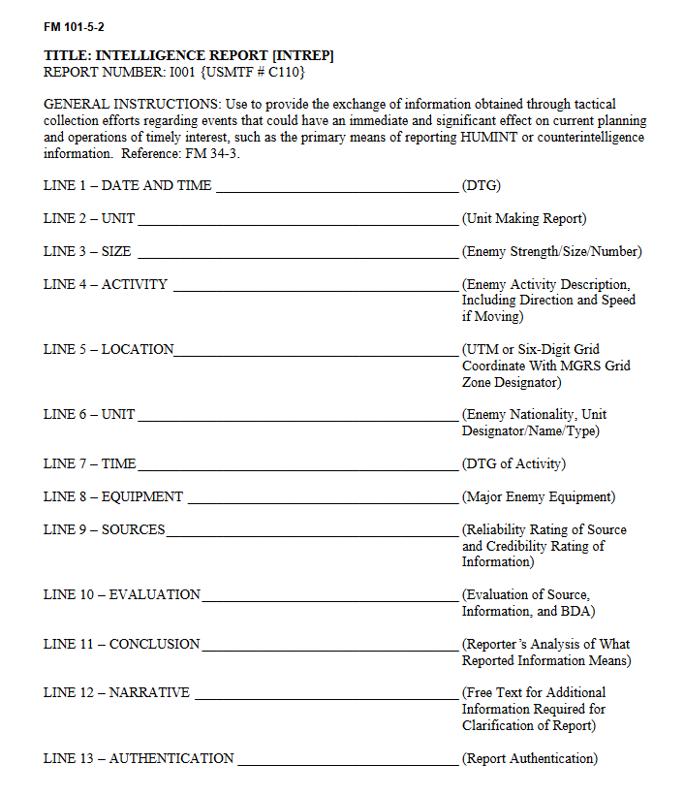
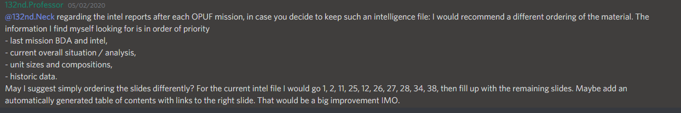
Information
Who:
What:
Where
When:
How:
Assessment
Conclusion
INFORMATION
ASSESSMENT
CONCLUSION
TO BE DECIDED

Slide 3
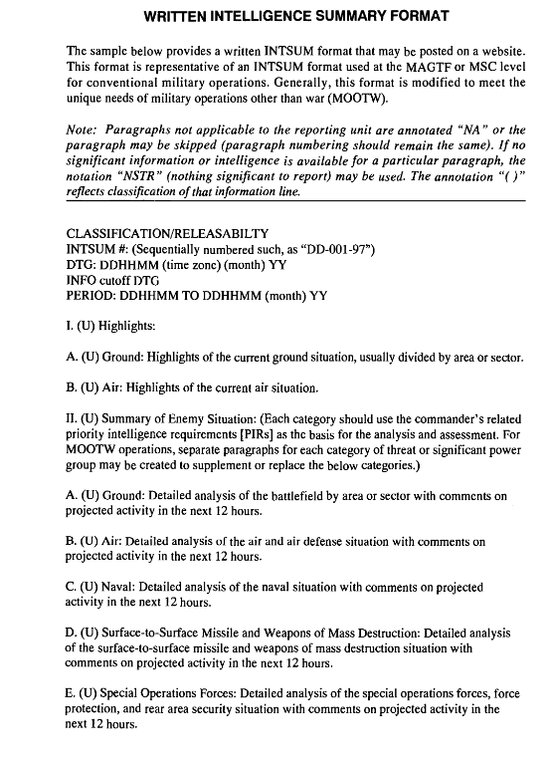
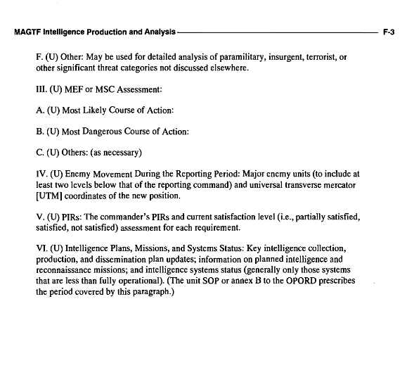
MAJOR EVENTS LAST PERIOD

Slide 4
MAJOR EVENTS LAST PERIOD
- Fill in major events here ( From BDAs or other injects). Can use symbols to show on the map. If additonal details is required, a seperate slide for that event can be provided.
INSERT MAP HERE
A
A
B
B
C
C
D
D
E
E
F
F

Slide 5
MAJOR EVENTS LAST PERIOD
- Fill in major events here ( From BDAs or other injects). Can use symbols to show on the map. If additonal details is required, a seperate slide for that event can be provided.
INSERT MAP HERE
A
A
B
B
C
C
D
D
E
E
F
F

Slide 6
BDA LAST PERIOD
- Fill in BDA reports. Can use symbols to show on the map. If additonal details is required, a seperate slide for that event can be provided.
INSERT MAP HERE
A
A
B
B
C
C
D
D
E
E
F
F

Slide 7
SUMMARY OF ENEMY SITUATION (facts)
Provide information about known enemy situation
Can be divided in multiple slides, divided per sector.
Facts only in this summary (Facts= reported information, known observations, etc)
Can be divided up in additional slides as required (Ground / Air / IADS (SAMs)
INSERT MAP HERE
A
A
B
B
C
C
D
D
E
E
F
F

Slide 8
ASSESSMENT OF ENEMY SITUATION (Short term)
Provide assessment of the likely enemy situation in the short term (next mission (next 12/24 hours) )
Can be divided up in Ground / Air / IADS (SAMs) as required. Use additional slides
INSERT MAP HERE
A
A
B
B
C
C
D
D
E
E
F
F

Slide 9
ASSESSMENT OF ENEMY SITUATION (long term)
Provide assessment of the likely enemy situation in the long term (+24 hours and beyond)
Can be divided up in Ground / Air / IADS (SAMs) as required. Use additional slides
INSERT MAP HERE
A
A
B
B
C
C
D
D
E
E
F
F

Slide 10
INTELLIGENCE GAPS
Provide a list of questions or gaps in intelligence, where taskings can be generated to collect information
INSERT MAP HERE
A
A
B
B
C
C
D
D
E
E
F
F

